Slide 1
Rocket Motors

Slide 2
Rocket Propulsion
Solid Fueled Rockets
Liquid Fueled Rockets
Hybrid Rockets

Slide 3
How Engines Work
In order for something to burn, you need a fuel + oxidizer
Fuel – the chemical that burns
Oxidizer – the thing that causes the burning
Compare this to airplanes
Where is their oxidizer?
Motor vs engine
Notes:
Motor is simple device that stores propellant, engine is more complicated with moving parts to convert stored propellant into thrust

Slide 4
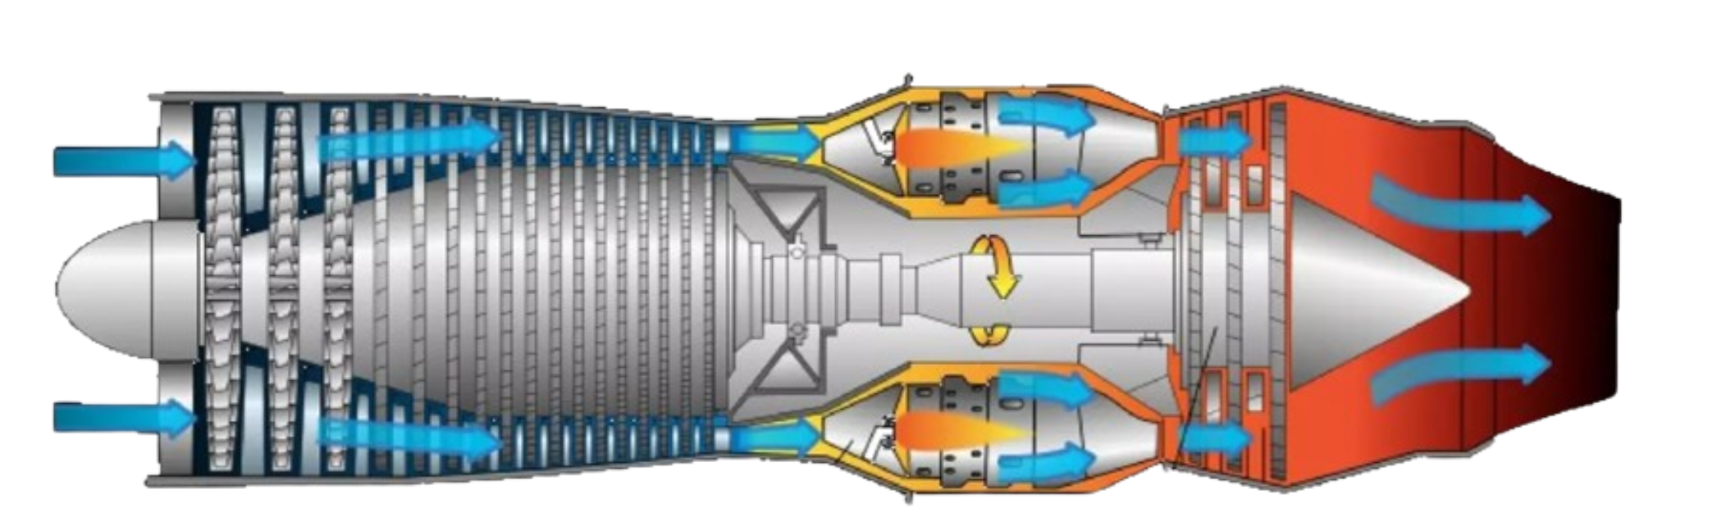
Airplane Motors

Slide 5
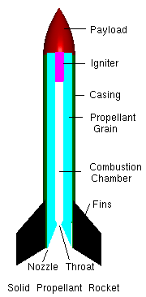
Solid Propulsion
Notes:
Importance of nozzles

Slide 6
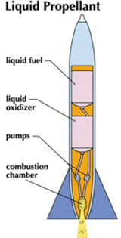
Liquid Propulsion

Slide 7
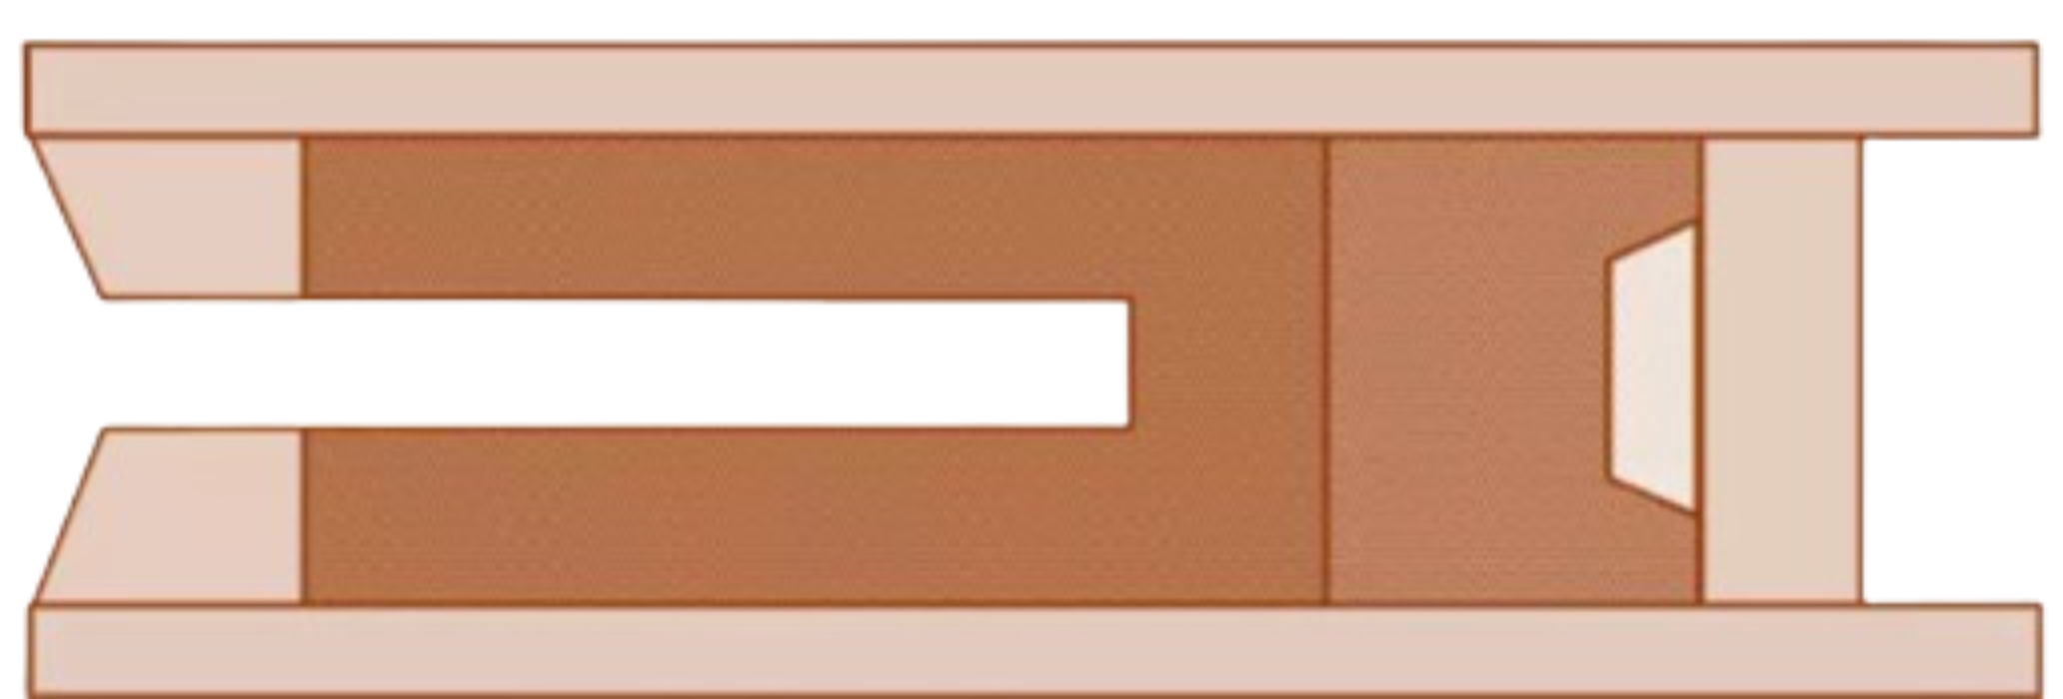
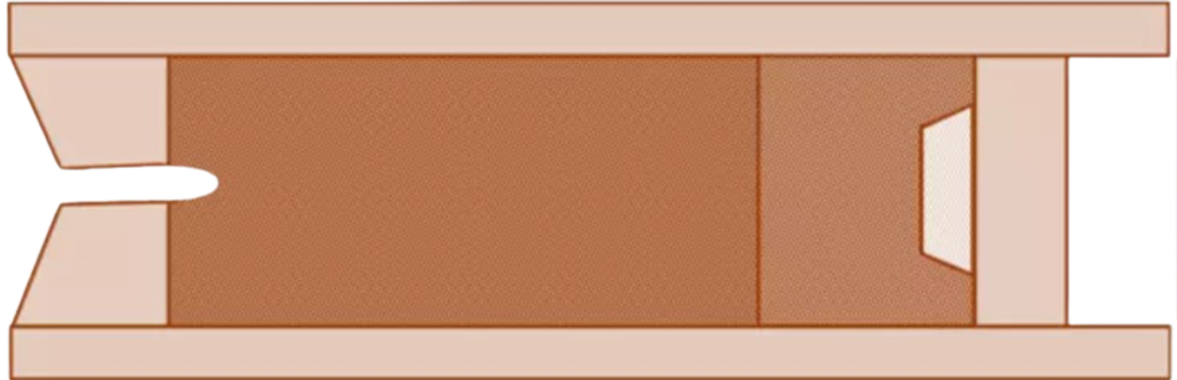
Core Burning vs End Burning
Notes:
However, to get higher thrust, the hollow core is used. This increases the surface area of the propellants available for burning. The propellants burn from the inside out at a much higher rate, sending mass out the nozzle at a higher rate and speed. This typically results in greater thrust.

Slide 8
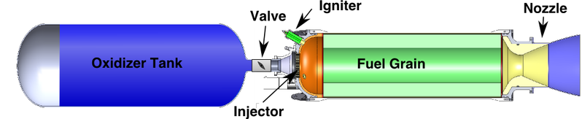
Hybrid Propulsion

